Slide 1

Final Presentation for
George C.A. “Gus” Conrades ‘90 Distinguished Fellowship
NerdHerd
Ditch the awkward mixers and all the tireless scrolling, connect authentically !
Your community, now CLOSER THAN EVER !
BUSINESS PROPOSAL

Slide 2

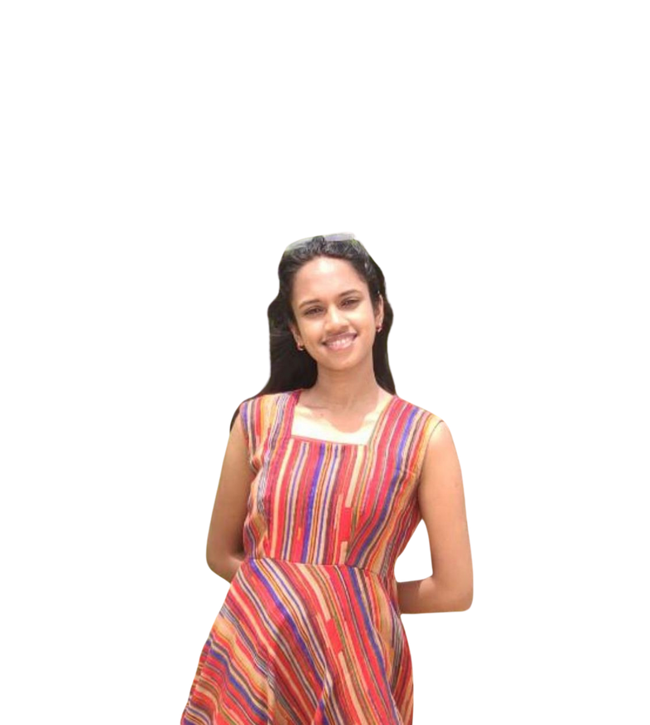
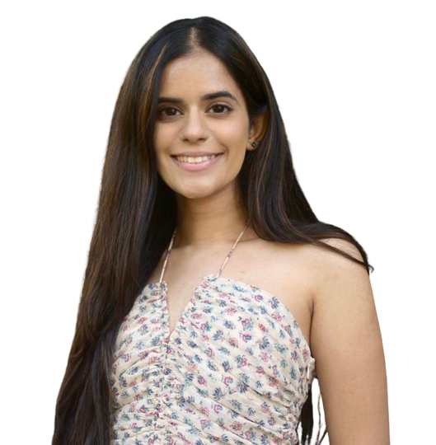

Meet the team
BRINDA SAI
  Bachelors (& Hons.) Industrial Engineering (2023)
  Research projects involving AI and management
  Aspires to lead and give back to society in the future
  Loves music, arts and sports
  An ambivert, who enjoys her tiny group of friends
  An AI enthusiast aiming to create a resource for students to kickstart a fulfilling life from the outset
ESHA KUMAR
  Bachelors in Information Technology (2020)
  3 years of work experience in Cyber Security
  Fueled by her passion for making this world a better place
  Creative, fun-loving person
  An extrovert, who loves meeting new people everyday
  A tech enthusiast eager to develop a platform for the student community to come closer together
It’s a match!
Imagine two brushstrokes, distinct yet intertwined, weaving a vibrant masterpiece. This is exactly how it feels being cofounders. While Esha is an impulsive innovator, Brinda is the calm strategist, and they work perfectly together to create magic.

Slide 3

Problem Statement
  Fragmented Community Engagement
4. Lack of Personalized Network
Challenges faced by
university community members
2. Missed Opportunities for Collaboration
5. Barrier to Cross-Disciplinary Innovation
3. Inefficient Networking Methods
6. Inefficient Utilization of Alumni Network

Slide 4

Proposed Solution
VISION- By leveraging cutting-edge matchmaking technology, we aspire to transform universities into a beacon of collaboration and innovation, where meaningful connections pave the way for groundbreaking achievements and enriching experiences, solidifying the legacy as a community that thrives together, across all spheres of life
01
Advanced Matchmaking Algorithm
02
Data Analytics for Predictions
03
Weekly Availability Slots
Personalized Networking Experience
04
05
Easy Profile Creation, App Interaction
06
Interest-Specific Packages and Features
07
System generated Ice Breaking Emails
08
Gatekeeping Algorithm for Security
09
Strict Policy Flow Implementations
We intend to build a platform that sparks meaningful interactions from the outset, creating a foundation for connections that evolve, deepen, and withstand the test of time.

Slide 5





User Segments
Faculties
Students
Alums
  Collaborative research with industry professionals, students, fellow faculties
  Mentorship
  Community engagement
  Discover study partners
  Seek help from fellow students in academics
  Engage in recreational activities
  Find mentorship
  Internship and job opportunities
  Find co-founders on campus
  Find investors
  Stay engaged
  Mentorship
  Find potential students for jobs/internships
  Invest in student-led innovative projects
  Find potential business partners
  Contribute to the Dartmouth legacy
Major target market

Slide 6





Competitive Analysis
SWOT Analysis for NerdHerd:
Some Indirect Competitors in the market for NerdHerd:
LinkedIn
Dartmouth Connect
  Powerful platform (AWS sagemaker)
  System generated ice breakers
  Addresses dual purpose - Professional and Recreational
  Community driven features
  Strong data privacy
  Platform for every personality type- Introverts, Ambiverts, Extroverts
  Initial adoption resistance
  Security concerns and getting user’s to trust
  Consistent user engagement and retention
GroupMe
Slack
CampusGroups
  New technology to improve matchmaking accuracy
  Extend services to other universities, corporate organizations and communities
  Potential competitors
  Cybersecurity risks
  Rapid technology changes
  Regulatory/compliance changes
OUR USP
Matchmaking based on mutual relevance
making the process easy and time-efficient

Slide 7



Marketing Plan
For instance, we have developed a marketing plan for Dartmouth College which will have it’s pilot during Fall term when most students first arrive on campus.
Mural Installation on Campus with QR Code
Channel: On Campus Installation
Key Metric: Unique Scan Rates, App downloads
Interactive
Launch Kiosks
Channel: On Campus
Key Metric: App Downloads, Participation Rates
Postcards in Hinman box
Channel: Print Media
Key Metric: App downloads
Emails to Faculties, Alums, Students
Channel: Email
Key Metric: App downloads, User activity
Social Media Campaign, Challenges
Channel: Social Media
Key Metric: User Interaction, Application Activity Tracking
Host Events in Collaboration with Student Council
Channel: Application
Key Metric: App downloads, User activity
High Level Strategy 1: AR based promotions; Channel: On Campus Event; Key Metric: App downloads, Participation Rate, Activation Rate
High Level Strategy 2: VR Networking Event; Channel: On Campus Event; Key Metric: App downloads, Participation Rate, Activation Rate

Slide 8








Potential Challenges
Users failing to attend scheduled meetings on the platform-
3 WARNINGS!
Encourage students to trust an AI based platform for sensitive info and career based decisions
The platform is being misused for unethical purposes
Overcoming app fatigue
Data privacy & security

Slide 9

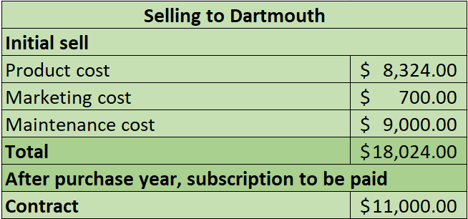
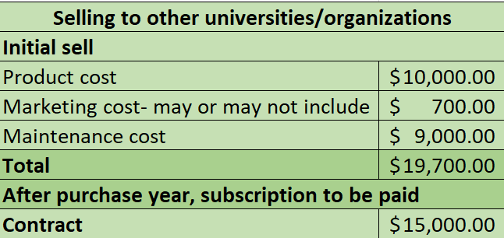
Revenue/Cost Model
Revenue streams
  Subscription based model for universities
  Selling data to: Ed-Tech companies, Market research firms, Event and conference organizers, Career coaches and professional development consultants
Assumption- Apart from Dartmouth in the 1st year, our target is to sell our platform to 3 other universities (or corporate companies/other organizations)

Slide 10
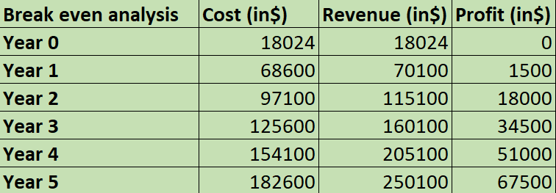
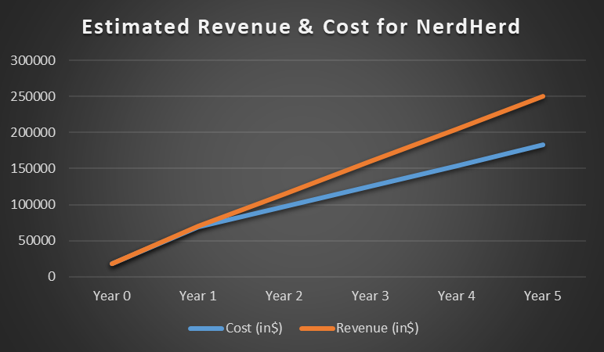
Revenue/Cost Model
Based on the proposed subscription model, our business will always be in profits
Where we see our business in the coming years: Used in many universities, corporate organizations and localities

Slide 11
NerdHerd
THANK YOU

Slide 12
APPENDIX

Slide 13
Competitive Analysis
SWOT Analysis for NerdHerd:
S (Strengths) | W (Weaknesses) | O (Opportunities) | T (Threats)
A powerful platfom (AWS Sagemaker) for building sophisticated model Caters to a specifically engaged population, offering high adoption potential Community-driven features, feedback loop System generated ice breakers Addresses dual purposes- professional and recreational User-centric design and experience Strong data-privacy policy flows | Initial adoption resistance Users might have security concerns Consistent user engagement | Introverts looking to find and interact with like-minded individuals Students looking for study buddies/hobby partners/co-founders on campus Students wanting to connect with alums with similar career trajectory for mentorship, jobs, investments. Alums/Faculties looking to give back to the Dartmouth community Leveraging new technology to improve matchmaking accuracy | Potential competitors in the market Rapid technological changes Cybersecurity risks Regulatory/compliance changes Potential economic downturns
Some Indirect Competitors in the market for NerdHerd:
LinkedIn
Dartmouth Connect
GroupMe
Slack
CampusGroups

Slide 14
Technology specification
Advanced Matchmaking Algorithm
Personalized Networking Experience
System generated Ice Breaking Emails
01
AWS Sagemaker algorithm for matchmaking, real-time inference, reinforcement learning
02
Personalized recommendations on the basis of of user preferences, goals and activities
03
To overcome initial contact anxiety, increase engagement, user retention, and bring diversity
Gatekeeping Algorithm for Security
Easy Profile Creation, App Interaction
Interest specific packages and features
04
To ensure only the right people stay in the network and prevent unauthorized access to personal data
05
Streamlined process, great UI to create user profiles highlighting essential user information, preferences
06
Package levels will be defined, indicating the group of interests for the user, eg. Recreational package
Strict Policy Flow Implementations
Weekly Availability Slots
Data Analytics for Predictions
07
AWS Sagemaker algorithm for matchmaking, real-time inference, reinforcement learning
Allows user to plan short-term, have more granular slots, more platform engagement
09
Data-driven analytics to predict match and engagement scores, risk mitigation, increased efficiency
08

Slide 15





Need/Opportunity Statement
Many students encounter obstacles when establishing meaningful connections with their peers. The challenge lies in finding like-minded individuals who share similar interests and are open to offering support within their areas of expertise.
Survey findings
Dartmouth College students struggle to:
Expand social circles beyond their program or current group
Initiate conversations due to diverse preferences, experiences, and social anxiety
Find opportunities to connect with alumni for insights and mentorship
Network through LinkedIn due to unpredictable and time-consuming conversations
Staying informed about job postings across various platforms
Connect with faculties across broader academic communities
This leads to
missed opportunities on a personal and professional level!
A streamlined matchmaking platform could address these challenges, enabling users to connect efficiently, saving time and energy otherwise spent searching for like-minded individuals. This platform would facilitate early relationship-building, paving the way for lasting and meaningful connections.
This is an attempt to make
Dartmouth’s tight-knit community inch closer!

Slide 16
Project Idea
Objective: To create an AI-based matchmaking platform to connect students, alumni, and faculties based on mutual relevance, cultivating symbiotic relationships.
Key Features:
  Quick Profile Creation
2. Packages for various connection interests
3. Smart Matchmaking algorithm
A streamlined process for students, alumni, and faculties to create profiles with essential information relevant to their respective profiles, highlighting their objectives, areas of interest, expertise, skills, and aspirations.
Package levels will be defined, indicating the group of interests for the user- for eg, the Entrepreneurship package would include finding a co-founder on campus or looking for potential early investors among the alumni. Similarly, the hobby package would include making a friend to explore an activity.
The platform would utilize AI algorithms such as AWS Sagemaker to develop recommendation models that analyze preferences, behaviors, and historical data to provide personalized recommendations. It predicts the compatibility of users based on skills, interests, and career goals.
4. Ice Breaking Emails
5. Weekly Availability Slots
6. Gamification: One Swipe Express Interest
Automatic facilitation of initial interaction introducing the two matched parties, making the further conversations easier to tackle. Ice breaking emails are sent out when the match has been accepted, this would help build context, and ease the awkwardness that otherwise happens in networking calls.
This allows users to plan short-term, have greater flexibility in choosing times that suit their schedules. It encourages users to regularly engage with the scheduling system, increasing user activity and participation. It also gives the benefit of having more granular time slots.
It eliminates the need for multiple action flows, making the process time-efficient. It also reduces the complexity of the process, thereby, increasing overall interaction and participation. Since it is easy to use, it captures a broader audience. Also enables a higher volume of interactions.
7. Alumni Connect (Jobs/mentorship/investment)
8. Gatekeeping Algorithm for Security
9. Filter for preferences
Matching with alumni with similar career paths can provide the following benefits:
  Career guidance and mentorship
  Job/Internship opportunities
  Help expand network
  Make better use of the resources at Dartmouth
  Investment in current student-led startups
Gatekeeping algorithm will help ensure that only the right people stay in the network. It will protect user privacy by preventing sharing of sensitive information or unauthorized access to personal data. The algorithm can also personalize content recommendations, tailoring them to individual user preferences and improving overall experience.
Users can express interest in matches based on their preferences at that point in time, allowing for better utilization of the application. The filter system can help users connect with a diverse range of people within their specified criteria. They can toggle between multiple use cases within a selected package.

Slide 17
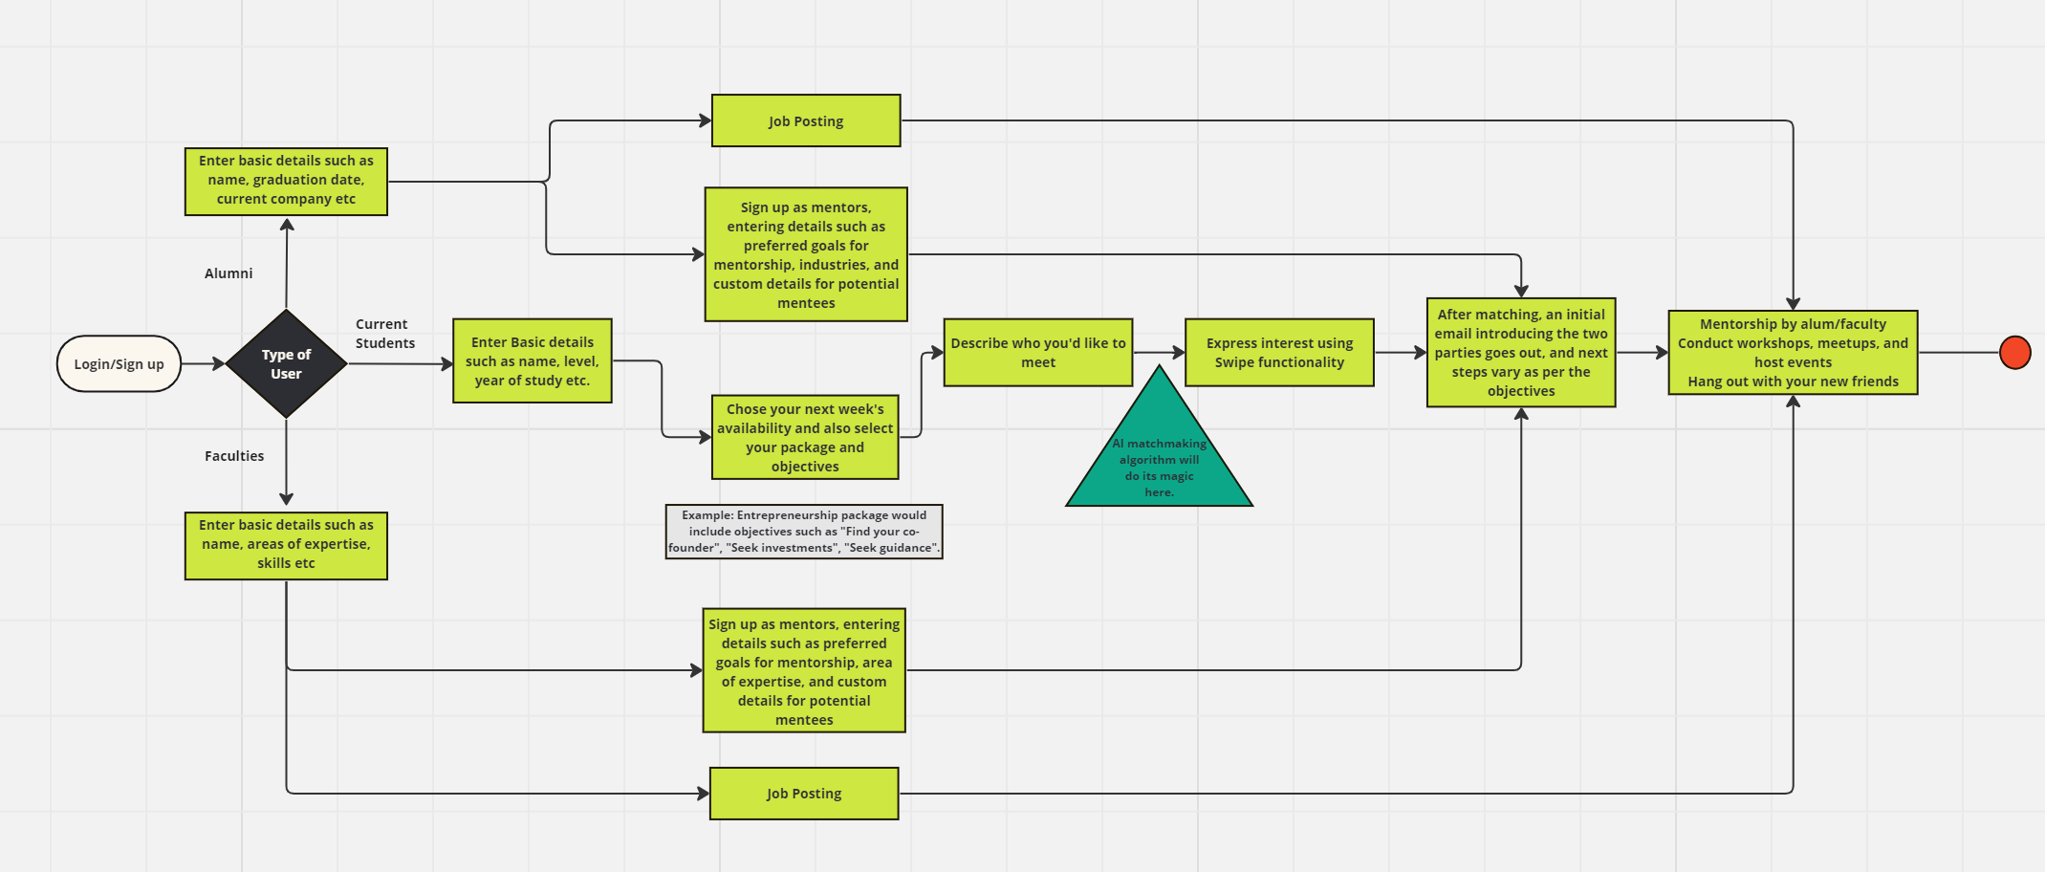
Project Idea
Additional features:
  Based on historical response data, users will get information about future connection responsiveness
  Ghosting over scheduled calls will pose a warning to the user (more than 3 times an action will be taken)

Slide 18







Project Plan
GOAL
SCOPE
Create a student platform for:
Fun & non-academic connections based on shared interests & connecting students with alumni mentors in similar professional fields
What it is not?
It is not a platform to get a job (like LinkedIn) &
it is not a dating app (like Tinder)
TIMELINE
5th & 6th months
Developing the platform front end
RISK
3rd month
Beta testing
Privacy and security concerns during meetings &
being ghosted by someone
7th & 8th months
Working on AI models and back end
4th month
Changes to prototype and testing
1st 2 months
Conduct student interviews to map pain points to platform features
Develop MVP of the platform
STAKEHOLDERS
Students, Professors, Alums - Only Dartmouth

Slide 19
Revenue/Cost model
Recurring revenue from Dartmouth College
Database Management Engineer ~ $5/hr
Security measure ~ $4/hr
ML engineer ~ $7/hr
App developer ~ $5/hr
Marketing ~ $4/hr
AI model ~ $8/hr
AI model breakdown-
  Notebook Instances: $0.058/hr
  Training Instances: $4.284/hr
  Inference Endpoints: $0.134/hr
  Model Hosting: $0.134/hr
  Data processing during training and inference for 1 tb: $0.023/hr
  Storage: $0.10/GB/month
  Data transfer out to the internet is approximately $0.09 per GB
Total labor and technology cost is ~ 32$/hr
M1-M4
M5
M6-M8
M9
. . . .
~ 15$
Develop prototype (with UI/UX)
~ 20$
Cost of domain for platform
~ 32$
Developing platform
~750$
Recurring platform maintenance cost-
2 Technical support engineers x 5 days a month x 5 hrs per day x 15$/hr

Slide 20
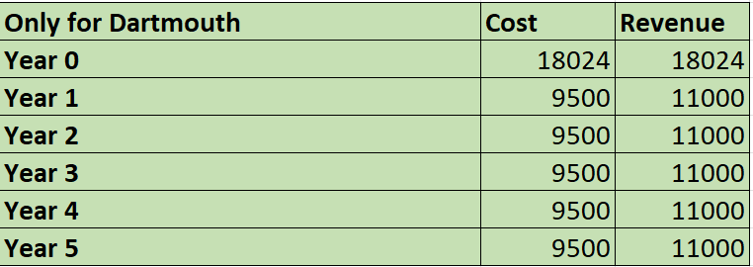
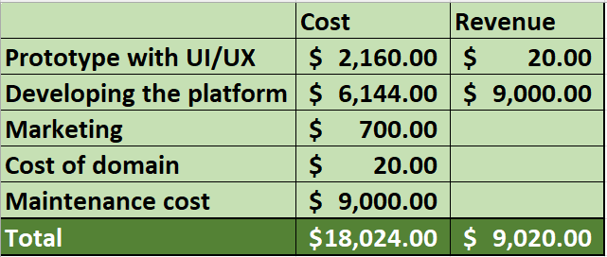
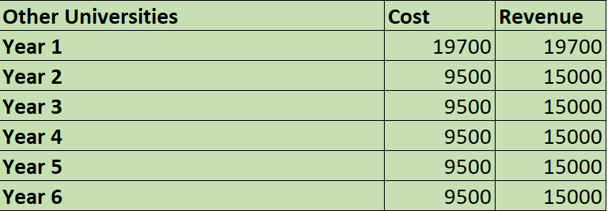
Appendix

